Slide 1



HEADQUARTERS
Emerging Leaders
WORKSHOP 1
  Leading Self
Notes:
Wanted to start off inaugural launch with current leaders.
Before bringing program to true EL, looking to existing leaders for evaluation.

Slide 2
  Welcome & Opening Remarks

Slide 3
SECTION I
  Introduction to Leadership

Slide 4


  Group Introductions
Please state:
  Your name, role, and how long you have been with Perry Homes.
  What you are hoping to gain from this program.

Slide 5
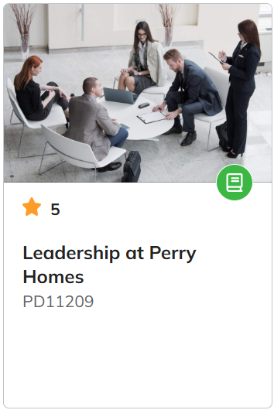

What does leadership mean to you?
In this course, we identified leadership at Perry Homes as having the opportunity to influence, impact, and ultimately lead the difference in alignment with our core values.
But what does leadership mean to YOU? How do our core values play a role in YOUR leadership?

Slide 6




Today’s Agenda
Executive Presence
Communication
Emotional Intelligence
Birkman Group Debrief
Each topic provides foundational information to build on progressively throughout the training.

Slide 7
SECTION II
  Birkman Group Debrief

Slide 8
5 MINUTE
  Break

Slide 9
SECTION III
  Emotional Intelligence
Notes:
Now that you learned about yourself, your tendencies, and how you show up in different ways when your stressors and triggers show up, and how you work with other people, we are going to focus in on a little more about emotional intelligence.

Slide 10


Defining Emotional Intelligence
Emotional intelligence (EQ) describes the ability to recognize, understand, and manage your own emotions as well as others’.
Personality
  Does not change
  Stable over lifetime
At a glance, there are four pillars of EQ:
  Self-Awareness
  Self-Management
  Social Awareness
  Relationship Management
IQ
EQ
  Does not change
  Stable over lifetime
  Can change
  Can be developed over lifetime
Notes:
We are going straight into defining emotional intelligence. I know you all have heard or know what emotional intelligence is, but I want to highlight the distinctions between IQ, personality, and EQ.
Your personality and IQ don't change over time, but EQ can change as you learn about emotional intelligence and practice EQ.
So as Parmis and Marisa mentioned, your birkman which gives insight into your personality, doesn't change unless you experience a life-altering event.
So with that said, as a leader EQ is the one thing you can rely on to be improved and developed over time. EQ is a powerful part of leadership.
At a glance, these are the 4 pillars that define EQ. Self-awareness, self-management, social awaress and relationship management. The next few slides are going to deep dive into each pillar of EQ.

Slide 11

Self-Awareness
On a scale of 1-10, how important is self-awareness to leadership?
  Dig deep. Recognizing personal values and how they influence priorities, boundaries, and choices.
  Have a realistic self-image. Know your strengths and weaknesses and how they show up in your day-to-day.
  Know your triggers. Understand what triggers certain emotions, behaviors, or patterns and why.
  Understand your impact. Be aware of how your demeanor comes off to others.
Notes:
Let's start with a question: on a scale of 1-10, how important is self-awareness to leadership? Think of the number in your head.
For the self-awareness pillar, I want to open up with a study that was done which indicated that most people aren't as self-aware as they believe.
In a study conducted by Tasha Eurich, PhD, 95 percent of participants rated themselves highly in self-awareness. However, more objective assessments revealed that only 10 to 15 percent of participants were truly self-aware.
Here is what self-awareness looks like: recognizing your personal values, having a realistic image, knowing what your triggers are, and understanding your impact on others.

Slide 12

5 minutes
Reflection Activity
In your binder, there is a worksheet for you to answer the following prompts.
  How do your personal values impact how you show up as a leader?
  What motivates you and why?
  What skills do you feel most confident in?
  What skills do you feel you need to or would like to improve?
  When stressful emotions show up at work, what situations tend to trigger them and how do you typically respond?
Notes:
So now, we briefly discussed what self-awareness is generally. We are going to pause and give you all an opportunity to practice self-awareness and reflect on your answers to the questions on your worksheet.
We are going to give you guys 5 minutes to complete the self-awareness section on your worksheet. There are 5 questions for you all to answer, and this is just for you; we won't share these.

Slide 13

Self-Management
What is a go-to strategy for managing your difficult emotions?
  Be adaptable. Adjust your approach, mindset, or behavior when circumstances change.
  Pause and evaluate. Decide how you want to respond and identify a healthy, productive solution.
  Do a rationality check. Ask yourself if there are rational reasons for the turn of events.
  Regulate, not repress. Find a middle ground between overwhelming emotions that can lead to outbursts.
Notes:
Self-management is all about taking responsibility for actions, emotions, and outcomes rather than deflecting or externalizing blame.
It's really about observing the ripple effect from your emotions, and you do this by doing the following:
- being adaptable, especially when circumstances change
-deciding how you want to respond vs. reacting and finding a solution.
- doing a rationality check, which looks like asking yourself if there is a reason and challenging the perspective for why things happened the way they did.
- and finding a middle ground between not sharing your feelings and suppressing it vs. communicating them in a healthy way.
So with that, I want to end with a question for us to talk about that focuses on self-management, which is, what is your go-to strategy for managing difficult emotions?

Slide 14
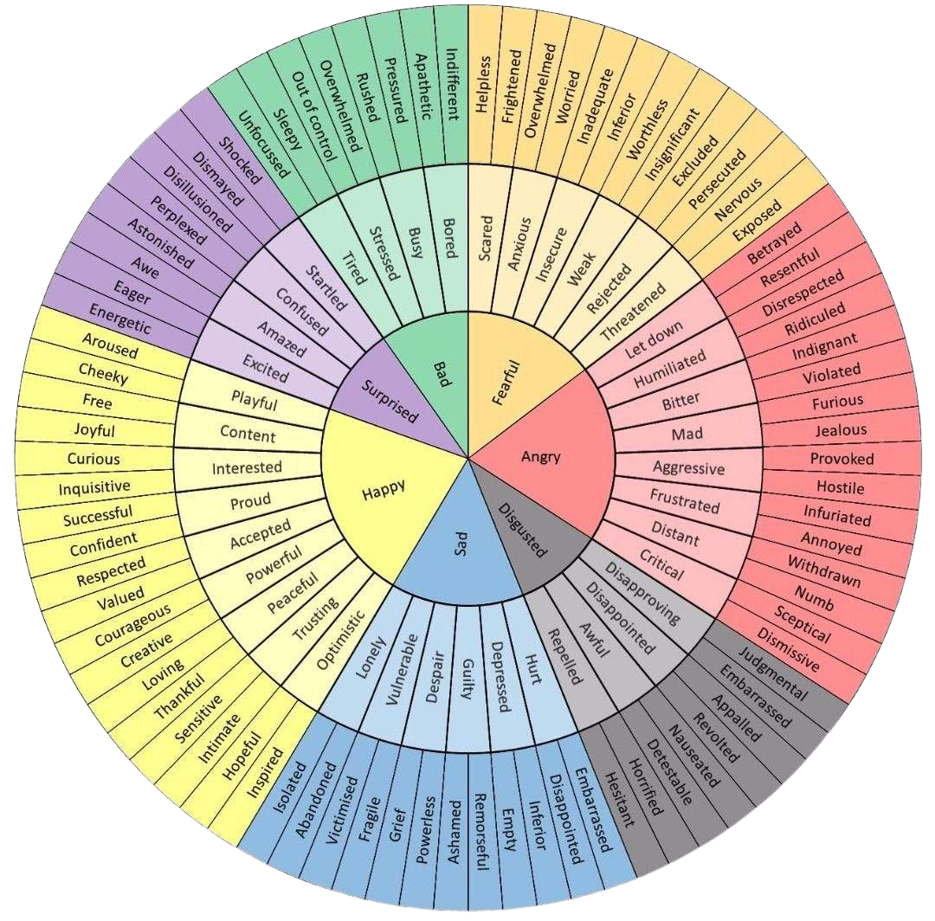
The Wheel of Emotions
Start with a basic emotion at the center, then move outward to find more specific feelings that best describe what you’re experiencing.
Notes:
Part of self-management is being able to name your emotions. We may already know this, but a highlight here is that the way you name and identify your emotions matters just as much for self-management.
So here on the screen and in your worksheet is a tool called an emotion wheel, which is used to identify, understand, and express your emotions more precisely
Some of you may already know what this is but if you don't, the way is work, is They usually:
Start with core emotions in the center (e.g., happy, anger, fear, sadness).
and they move outward to more specific emotions (e.g., frustration, disappointment, vulnerable).
and an emotion wheel uses color coding to group related feelings.
so an example here:
You’ve just been offered a stretch assignment — a bigger opportunity with more visibility and responsibility. As you check in with yourself using the emotion wheel, you notice something feels uncomfortable.
Looking at the center of the wheel, you identify fearful.
Moving outward, you recognize you’re actually anxious.
Going one layer deeper, you realize what you’re truly feeling is worried. The emotion is actually worried (even though at first it just feels like fear or anxiety).
The emotion wheel highlights that emotions and stress are not random — they operate in a loop. An emotional trigger creates a feeling, and that feeling drives a response. When we don’t pause to identify the emotion, the loop runs automatically. But when we name the emotion, we interrupt the cycle and choose a more intentional response.
Emotional Trigger → Emotion → Response
Instead of letting that worry drive self-doubt or hesitation, you choose a thoughtful response:So maybe a good r esponse for this example situation is:
“I’m excited about this opportunity, and I also feel a little worried because it’s new territory for me. I want to make sure I do it well, so I may ask for clarity and feedback along the way."
A response like this shows you that that’s the loop working in your favor — awareness turning into intentional leadership.
Now that we understand how emotions drive responses, it’s helpful to recognize what actually sets off the loop. Triggers can come from outside us or from within:
External triggers — things like deadlines, conflicts, noise, interruptions, or difficult conversations.
Internal triggers — things like negative self-talk, memories, fatigue, hunger, or worrying thoughts.
Recognizing triggers is only the first step. Once we know what sparks our emotions, the next question is: What can we actually influence?

Slide 15

Control
The elements of an issue you can directly control.
The elements that you can influence indirectly.
Influence
The elements that are outside of your control.
Accept & Adapt
The Locus of Control
Notes:
So that brings us to the locus of control wheel. This is another tool that helps us self-manage.
The concept of locus of control comes in — understanding what’s within our control versus what’s outside it. Focusing on what we can control helps us respond intentionally rather than react automatically to every trigger.
so there are 3 layers:
control- things you have full control over.
These are actions and decisions that are fully yours—where you can have immediate impact.
influence: things you can affect or partially shape but don't fully control
are areas where you can shape the outcome indirectly—where your actions affect others or the situation.
accept: things beyond your control or influence.
these are things outside of your control. You can only adjust and adapt how you respond.

Slide 16
What category do each of the items below fall under?
Control
  Company culture
  Your responses to stress
  Resource constraints
  Team norms
  Others’ personalities
  Your decisions
  Engagement levels
  Market shifts
  Your attitude
  Competing demands
  Others’ behaviors
  Policies
  Your actions
Influence
Accept & Adapt
Notes:
so a group, to help us understand the locus of control wheel better, let's brainstrom things that fall in each layer.
Control
Your actions
Your decisions
Your attitude
Your responses to stress
Influence
Others’ behaviors
Company culture
Team norms
Engagement levels
Accept & Adapt
Policies
Market shifts
Others’ personalities
Competing demands
Resource constraints
---------
control
Your actions, your responses in meetings, your attitude, schedule or how you mange your time for the most part right, how you respond to stress.
This can look like controlling our focus and effort by prioritizing the most important parts of the task.
controlling your time management to the best way you can by Planing small, actionable chunks to make progress efficiently.
and controlling your approach and mindset by choosing to stay calm, organized, and focused instead of panicking.
The Influence layer:
you can influence something by negotiating or requesting support such as ask a teammate for help, delegate minor parts, or request feedback early.
Managing expectations: Communicate progress updates or realistic timelines to stakeholders.
You can influence Other people’s behaviors, work culture, project timelines. You can’t control them, but you can impact them through communication, persuasion, or teamwork. you can also influence team collaboration or client satisfaction
Lastly is the Accept & Adapt layer:
Things that fall in this layer are thing you should Adapt and Accept
This can look like: The fixed deadline itself: The calendar, the stakeholder’s timing, or organizational constraints.
Other people’s responsiveness: Colleagues may be slow to reply or unavailable when you need input.
Unexpected interruptions: Fires, last-minute changes, or shifting priorities you can’t prevent.
External pressures or resource limits: Systems, tools, or processes that aren’t flexible.
Here’s a strong transition statement you could use:
I show you this toold because Understanding the locus of control is a powerful tool for emerging leaders because it helps them distinguish between what they can directly shape, what they can influence, and what they need to accept. By focusing energy on areas they can control and influence, leaders become more effective, resilient, and strategic, rather than wasting time and stress on things beyond their reach. This clarity not only improves decision-making but also models emotional intelligence and accountability for their teams.
so now that I showed you both tools, we are going to practice using both of them!

Slide 17
10 minutes
Pair-Up Activity
Think of a situation that triggered a strong, negative emotion. Share with the person next to you. Then, answer the following questions.
  Which emotions within each layer of the wheel best describe what you felt in that situation?
  What specific actions triggered these emotions?
  What beliefs or assumptions might have shaped your reaction?
  What was in your sphere of control, influence, and accepting/adapting?
Notes:
So now we are going to complete an activity. In a second you will pair up with the person next to you and you are going to think of situation that triggered a strong negative emotion. it can be work or personal. Share the situation with your parthner and then using the emotion wheel and the locus of control wheel you are going to answer the following questions.
1. which emotions within each layer best describe what you felt in that siutation.
2. what specific actions triggered these emotions.
3. what beliefs or assumptions might have shaped your reaction
and 4. what was in your sphere of control, influece or acception/adapting.
and because this is new, I am going to walk through a made up example before you start doing parthner work so you can get an idea of how the activity should go.
**Example:**
*Imagine you were working on a critical project with a tight deadline. One day, a key team member unexpectedly missed an important deliverable, which delayed the entire project timeline. This triggered a strong negative emotion anger.*
* **Which emotions within each layer of the wheel best describe what you felt?**
anger (inner layer), frustrated (middle layer), and more specifically, annoyed (outer layer).
* **What specific actions triggered these emotions?**
The missed deliverable and the resulting project delay.
* **What beliefs or assumptions might have shaped your reaction?**
Perhaps you believed that everyone should always meet deadlines, or assumed the delay would cause the project to fail. I assumed the team member had plenty of time to complete the deliverable.
* **What was in your sphere of control, influence, and accepting/adapting?**
* *Control:* How you responded—communicating calmly with the team member, adjusting your own work priorities to meet the project deadline.
* *Influence:* Helping the team member get back on track, negotiating deadline adjustments with stakeholders, and the rest of the team members.
* *Accept:* The fact that the delay happened and that you can’t change past actions immediately.
---
Okay, any questions before we break?
Come back, can I have two groups share?
Great thanks for sharing, so this activity was aimed at leaders to understand what they can control, influence, or accept as it is crucial for self-management. These tools can help yiu regulate your emotions, prioritize actions, and maintain focus under pressure.
****Provide example
Give a Heads Up If You're Feeling Off
Be sure you're not projecting your feelings onto others but proactively letting them know that you aren't in the best mood. This way, they know what to expect if you're acting differently than usual and don't take it personally.
Express Your Needs
Clearly communicate any specific needs or preferences you have related to your emotional state. Whether it's requesting support, understanding, or space, expressing your needs helps others know how they can best respond to your emotions.
Maintain a Professional Tone
While it's important to be honest and authentic about your emotions, maintain a professional demeanor during your discussions. Avoid venting excessively or making personal attacks, and strive to keep the conversation constructive and respectful.

Slide 18


Self-Awareness
Self-Management
Social Awareness
Relationship Management
Notes:
so we talked alot about the first 2 pillars of emotional intelligence and if you noticed the first 2 pillars are focused on YOU. this is where the transition happens where you start to focus on other people.
so let's jump into social awareness. of course self impacts others but social awaress is tuly and understanding of others.

Slide 19

Social Awareness
What patterns in behavior or engagement do you notice on your team?
  Read the room. Notice how others are feeling, even when it isn’t explicitly stated.
  Manage yourself. Adjust your body language, communication style, timing, or approach in real time.
  Be empathetic. Understand how experiences, pressures, and priorities shape someone else’s reactions or decisions.
  Pay attention to social cues. Discern whether someone needs space, clarity, reassurance, or a direct answer.
Notes:
to go even deeper, social awareness includes picking up on tone, facial expressions, energy shifts, and what’s not being said.
Read the room
Manage yourself
Be empathetic
Pay attention to social cues
Facilitator Explanation:
Let’s unpack these:
Read the room means noticing the emotional undercurrents — what people feel but don’t say.
Manage yourself means adjusting how you show up based on what you sense — your tone, body language, timing.
Be empathetic means understanding the pressures or experiences others face that influence their decisions.
Pay attention to social cues means noticing subtle signs — like someone needing space or reassurance — and responding accordingly.
Lastly, here is a self reflection question for you to fill out in your worksheet, What patterns in behavior or engagement do you notice on your team?
-few seconds- transition, okay so we have a whole group discussion,

Slide 20
10 minutes
Open Discussion Activity
Imagine your team members are juggling multiple priorities, and recently, mistakes or missed details have started appearing where they normally wouldn’t. The employees are still completing tasks, but the quality of interaction and reliability has changed slightly.
How can we address this shift in a way that personalizes the interaction and maintains trust with each of the following types of employees?
  A defensive employee
  A disengaged employee
  A high performer under stress
Notes:
so we have been talking about how Part of social awareness is noticing patterns and shifts in behavior, especially as a leader responsible for staying connected to your team - and also knowing how to best navigate these challenges based on what you know about each individual and personalizing your approach.
so, imagine your team members are juggling multiple priorities, and recently, mistakes or missed details have started appearing where they normally wouldn’t. The employees are still completing tasks, but the quality of interaction and reliability has changed slightly.
How can we address this shift in a way that personalizes the interaction and maintains trust with each of the following types of employees?
So as a whole group, what do we think, what factors should we be mindful of and how can we communicate our message if we are dealing with a defensive employee??
1. Defensive Employee
so to start off, how should our Tone be?
Reassuring, neutral, low-threat
Signs/Behaviors:
Reacts quickly to feedback with excuses or pushback
Avoids admitting mistakes
Becomes guarded or closed off in conversations
Approach with curiosity, not judgment
Use “I” statements to reduce defensiveness (“I noticed…” rather than “You did…”)
Create a safe space for dialogue — reassure that the goal is support, not blame
Communication Strategies:
Listen actively without interrupting
Ask open-ended questions to understand their perspective
Acknowledge their feelings before moving into problem-solving
Support Needed:
Clear expectations delivered calmly
Reassurance that mistakes are learning opportunities
Possibly coaching or mentoring focused on emotional safety
example:
“I want to share an observation and get your take. I’ve noticed you’ve been quieter in meetings recently, and I may be missing something. Your perspective is valuable, and I want to make sure you feel comfortable contributing. Is there anything getting in the way right now?”
Why this works:
It frames the issue as a shared gap rather than a personal failure and invites conversation without pressure.
2. Disengaged Peer
Tone: Direct, grounded, re-connecting
Signs/Behaviors:
Shows minimal enthusiasm or energy
Misses details or deadlines repeatedly
Limited participation in team discussions
Physically or emotionally checked out
Check in personally to understand underlying causes (burnout, lack of clarity, outside stress)
Reconnect their work to meaningful goals or team impact
Involve them in setting realistic priorities to regain ownership
Communication Strategies:
Use motivational, positive language
Recognize small wins to build momentum
Provide opportunities for input and choice in their tasks
Support Needed:
Clarity on priorities and expectations
Flexibility if needed (schedule, workload)
Recognition and encouragement to rebuild engagement
Focus: Ownership and impact
“I’ve noticed you haven’t been as vocal in meetings lately, and it’s been noticeable. Your input matters to the team, and I need you more engaged in those conversations. What’s going on from your side?”
Why this works:
It names the behavior clearly and reinforces relevance, signaling that disengagement doesn’t go unnoticed—but the relationship still matters.
3. High Performer Under Stress
Tone: Supportive, respectful, steady
Signs/Behaviors:
Working longer hours or pushing harder than usual
Perfectionism or reluctance to delegate
Increased irritability or fatigue
Mistakes appearing despite high effort
Personalized Approach:
Acknowledge their hard work and value
Encourage healthy boundaries and self-care
Help them prioritize and delegate to reduce overload
Communication Strategies:
Be direct but supportive about workload limits
Collaborate on problem-solving, don’t just assign more tasks
Regular check-ins to monitor stress levels
Support Needed:
Resources or assistance to share workload
Permission and encouragement to take breaks
Possibly coaching on resilience and stress management
Focus: Recognition without lowering expectations
“I know you’ve been managing a lot, and I want to acknowledge that. I’ve also noticed you’ve been quieter in meetings, and I miss your perspective. Your voice carries weight, and I’d like to see you more engaged. Let’s talk through what might help right now.”
Why this works:
It balances care with expectation, reinforcing trust while encouraging continued contribution.

Slide 21
Low Emotional Intelligence
High Emotional Intelligence
Aggressive
Assertive
Demanding
Ambitious
The Importance of Descriptors
Bossy
Strong-Willed
Confrontational
Decisive
Critical
Detailed
Picky
Careful
Perfectionist
Neat
Notes:
okay so with that we are getting near the end of the EQ section but I wanted to highlight this chart.
on the left are low EQ descriptos and on the right are high EQ describtors.
“Before I reveal the high EQ descriptors, I want you to pause and think about the low EQ descriptions on the left.
Your task is to reframe each low EQ descriptor in a neutral or even positive way—without yet knowing what the high EQ version looks like.
For example, if the low EQ word is ‘defensive,’ maybe a reframe could be ‘protective’ or ‘cautious.’
Take 3–5 minutes silently or jot down your reframes.
This exercise isn’t just about EQ — it mirrors what we see in our Birkman profiles.
Birkman highlights behaviors, interests, and needs — but what looks like a ‘blind spot’ to one person can be a strength or natural way of working for another.
For example:
Someone with a low tolerance for ambiguity might seem rigid or inflexible to others. But that same trait can mean they are highly detail-oriented and dependable.
Conversely, a person with a high need for social connection might seem distracting to a more task-focused colleague, who in turn might be seen as aloof or unengaged.
Our blind spots show up when we interpret others’ behaviors only through our own lens or EQ level, without recognizing different wiring or experience.
tie back to Birkman and blind spots for others that differ or have lower/higher levels of certain traits

Slide 22

Relationship Management
How does a leader shape psychological safety?
  Personalize interactions. Get to know people beyond the surface level and demonstrate interest in them.
  Conflict management. Address tension directly and constructively with an emphasis on resolution.
  Encourage development. Be supportive of needs by offering feedback and guidance respectfully.
  Recognize and reinforce. Celebrate milestones and achievements in a timely and meaningful manner.
Notes:
“Lastly, we have Relationship Management.
Before we get into the strategies, I want you to go back to your worksheet for one a self-reflection question for this section:
👉 How does a leader shape psychological safety?
Because at its core, relationship management is not just about being relational—it’s about creating an environment where people feel safe to contribute, grow, and be honest.”
“Strong leaders take the time to truly understand their people:
What motivates them
How they prefer to communicate
What matters to them professionally and personally
This does not mean becoming best friends with everyone.
It means being intentional about connection.
When people feel seen and valued:
➡ trust increases
➡ engagement increases
➡ performance follows.”
Simple leadership behaviors that build connection:
Greet people by name
Remember that the little things matter
Take a moment to check in, not just check on tasks
Those small actions send a big message: You matter here.”

Slide 23
5 minutes
Reflection Activity
In your binder, there is a worksheet for you to answer the following prompts.
Think about a current working relationship that you feel could be improved (peer, direct report, cross-functional partner, etc.).
  What specific aspects of the relationship would benefit from improvement?
  What steps can you take to be more intentional about building this relationship further?
Notes:
to close this section out, we have a reflection activity for you to complete. This one is for you and won't be shared.
think about a current working relationship that you feel could be improved.
what spefici aspects of the relationship with benefit from improvement and what steps can you take to be more intentional about building this relationship further?
“Relationship management is what we’re building.
Communication is how we build it.
I am going to pass it over to Michelle to
talk about the communication skills that elevate your leadership presence and influence.”

Slide 24
SECTION IV
  Communication

Slide 25
  True or False?
We need more communication and information in the organization.
Communication is more than a competency. It’s the very essence of your leadership.

Slide 26
10 minutes
Group Activity
In groups of five, you will be given a large piece of paper to discuss and outline the most essential do’s and don’t of one of the types of communication below in T-chart format.
  Email
  Phone Call
  Teams Chat
  Group Meeting
  1:1 Meeting
Be prepared to present your final product,
Notes:
Think about your experiences communicating with colleagues, team members, or customers.
Identify behaviors, phrases, or approaches that strengthen connection and clarity (Do’s).
Identify behaviors, phrases, or approaches that create confusion, tension, or disengagement (Don’ts)
Verbal: Tone, volume, verbiage
Nonverbal: Body language, facial expressions, eye contact
Listen to understand rather than speak
Summarize what the speaker said
***Each group covers
Email
Group Meeting
1:1 Meeting
Phone Call
Teams Chat

Slide 27
  Where Conversations Go Sideways
Every conversation has layers: the words, tone, timing, and what people assume, all at once.
Friction Points
Communication is an inherently complex process.
“The single biggest problem in communication is the illusion that it has taken place.”
  Contextual
Occurs from overuse of jargon or other differences that make a message unclear or inaccessible
  Perceptual
Occurs when individuals interpret the same message differently based on their own experiences or assumptions
  Emotional
Occurs in high-pressure situations or when individuals feel overwhelmed or unacknowledged.
Notes:
So, most conversations don’t really fall apart because of the topic or information itself, but it’s more about the layers around that information and that’s what makes communicating so complicated right. And the biggest part here kind of goes back to that question you guys just answered where you all could see different kind of priorities around what you notice first or what seems the most important or glaring - and all of that comes from the assumptions that either party of the conversation is making.
For instance:
Maybe you send a short Teams message because you’re busy and in the middle of something - but to someone else, it comes off as snappy or dismissive. Or vice vera.
Or if someone just asks me out of the blue, “We need to talk later,”’ it kind of makes me feel like, “Ohhh this must be serious…am I in trouble?” and more often than not, they really just meant it surface level and wanted to touch base about something completely routine or normal.
So anyway - a lot of room for interpretation right, and so part of becoming a strong communicator is understanding those nuances and why they might happen.
Now, there are three friction points that consistently affect how conversations land.
And so starting off easy, there’s contextual friction right - where some sort of miscommunication happens because maybe there are too many technical words and jargon or acronyms being used, or there’s just misalignment somewhere objectively from possibly missing information that is causing confusion or tension, and the message just isn’t making it across as intended. Arguably, this one I think is the easiest fix.
Then, there’s perceptual friction where things get a bit stickier, and this is when the message contextually probably has all the information needed, but what gets in the way of understanding is that everyone is coming from a different perspective based on their own values or
experiences - or to no surprise - the unspoken assumptions we all tend to make and kind of fill the gaps in ourselves.
And even stickier than that is emotional friction which happens when people’s stress behaviors come out because their needs aren’t being met and they feel invalidated or misunderstood or just all around overwhelmed. This one requires a lot empathy and outward perspective taking outside of your own bubble.
So a lot of different areas where conversations can go sideways, and so there’s a quote that I always think back to here, and it’s that “The single biggest problem in communication is the illusion that it has taken place.”
Obviously, everyone knows how to communicate. We do it everyday sometimes without a thought, but to really truly communicate, not only do you need to be saying your piece, but saying it in a way that others understand and are receptive to, and vice versa. Which can be hard, especially with those unspoken assumptions or expectations.

Slide 28






  Four Strategies to Communicate Effectively
Showing Up as Yourself
Managing Dynamics
Bullding Connection
There are endless tips and tricks on how to communicate, but we’ve boiled it down to four of the most meaningful points within any given conversation.
Framing the Message
Notes:
And so there’s a laundry list of tips and tricks out there on how to best communicate, but we’ve taken the liberty to boil down the four most crucial points of any given conversation that you’ll sometimes need to bounce around but it pretty much goes in this foundational cycle of first, establishing an authentic presence, then building connection points, then shaping the narrative, and finally being able to manage the dynamics of the conversation as things shift and progress.

Slide 29

Showing up as yourself means being clear and genuine in your interactions instead of feeling like you need to perform.
  STRATEGY #1
What This Looks Like:
  Showing Up as Yourself
  Lead with integrity; don’t ask for what you can’t or wouldn’t do.
  Model consistency in words and actions.
  Communicate with certainty.
  Adapt your approach without losing your focus or stance.
  Avoid over-politeness that blurs expectations.
  Demonstrate openness and vulnerability.
Notes:
So here’s the first piece of authentic presence. This is the first thing people sense in a conversation — before your tone, before the content, and essentially this is how they sense your intention and whether it’s genuine or not.
In order to get buy-in from others, they need to know you’re being sincere. Raise your hands if you’ve ever had an interaction with someone where you could tell they weren’t being entirely true to themselves or you, and you could kind of tell there were reservations that weren’t being revealed in conversation.
Okay, now on the flip side, what feelings or signals do you notice in yourself when you’re starting to hold back in a conversation?
B ex: Not getting mad or feeling any emotion
Sometimes when conversations happen, especially difficult or sensitive ones, we kind of try to avoid stepping on each other’s toes and we start to hold back on sharing our truth. Things get awkward - I get it - we’ve all been there. But nothing is going to progress or change or have a productive outcome if you can’t have intentional vulnerability and take off that mask.
The most progress comes when you can get out of your comfort zone. So with intentional vulnerability, this is really making an ACTIVE and deliberate choice to share your true thoughts and feelings without fear of being judged or taking away from the credibility of who you are or how you want to be perceived right. And that takes humility, but you’d be surprised to see that once you open up first then that opens the channel for others to be more authentic with you as well.
You just have to take that first step to open the communication channel. And then taking off the mask really - and especially in the workplace, letting people see the person you are behind the role. Of course, this comes with a certain level of professionalism, but professionalism doesn’t mean that you aren’t allowed to have any thoughts but positive ones, and sometimes it’s more relatable to others that way. And in your personal life too - it’s sometimes easiest to pretend like everything is okay and to be agreeable, but there’s a lot of value in conversations to be had when you’re being authentic since everyone comes from such diverse backgrounds and we can all show each other more perspective right.
So anyway, you can’t have a good conversation if someone can sense that you’re not being authentic, because it’s hard to establish that level of trust there if they feel you’re putting on a performance.
So your presence is the first part that sets the tone for your communication and interactions and really is the entry point for building rapport with others - So now, with authentic presence, we start to move into the next part of the cycle where we start paying attention to how people respond to cues so that we can start to build connection.

Slide 30

Building connection focuses on strengthening relationships while learning to navigate and appreciate various perspectives.
  STRATEGY #2
What This Looks Like:
  Building Connection
  Listen to understand, not just respond.
  Recognize others’ circumstances or feelings before stating your own needs.
  Create a two-way dialogue by being open & approachable.
  Involve others early in planning.
  Motivate by letting people help shape direction.
  Focus on shared goals and highlight areas of alignment.

Slide 31

Framing the message involves guiding how others understand your ideas so your message lands with clarity.
  STRATEGY #3
What This Looks Like:
  Framing the Message
  Prioritize the audience; simplify and get to the point.
  Answer the unspoken “What does this mean for me?”
  Narrate your thinking; assume shared context doesn’t exist.
  Involve reasoning behind decisions.
  Avoid burying decisions in excessive background info.
  Reinforce priorities and strategic direction regularly.
  Communicate on multiple levels at once.

Slide 32

Managing dynamics requires maintaining the flow and momentum of communication among barriers.
  STRATEGY #4
What This Looks Like:
  Managing Dynamics
  Influence attitudes/behaviors through tone & composure.
  Pay attention to nonverbal signals.
  Recognize resistance often comes from perceived loss.
  Adapt in real time to energy and emotion.
  Tailor the level of context-giving based on familiarity, hierarchy, and complexity.
  Ensure alignment above surface-level agreement.

Slide 33
  Practice Being the Last to Speak
“Here is the problem.”
“This is what we should do.”
“I’m interested to know your opinions.”
Notes:
Ask participants: What is the problem with this?
If you have positional authority, your casual comment can land like a directive.
“That might not work.”
To you: a thought.
To them: a decision.
Leaders often underestimate how much weight their voice carries.
The skill to hold your opinions to yourself until everyone has spoken does two things:
It gives everybody else the feeling that they have been heard and have contributed
You get to hear more authentic perspectives from everyone else before you share your own.
Leaders who ask thoughtful questions elevate discussion.
Leaders who only provide answers can unintentionally shut thinking down.
Strategic silence

Slide 34

  Communication Shutdowns
  That’s not the way we do things around here.
  We don’t have time.
  We’re not ready for that.
  It’s too big of a change.
  We tried that before and it didn’t work.
  It’s not possible.

Slide 35

Clarifying
"Can you explain that further?"
"I'm not sure I understand what you mean by...
Open-Ended Questions
"What led you to that conclusion?"
"How did that make you feel?“
  Ways to Listen, Respond, & Engage
Acknowledging
"I understand where you're coming from."
Summarizing
"So, what you're saying is..."
Reflecting Feelings
"That must be frustrating...”
"That’s so exciting!"
Encouraging Words
That's interesting!"
"Tell me more!"
Affirming
"I appreciate your perspective."
"Thanks for sharing your thoughts with me!"
Notes:
Questions Can Signal Either Curiosity or Doubt
“How did you arrive at that?”
Can feel like:
• Genuine interest
• Interrogation
Intent doesn’t determine impact. Delivery does.

Slide 36
5 MINUTE
  Break

Slide 37
SECTION V
  Executive
  Presence
Notes:
Executive presence can be a difficult concept to define because it isn't a technical skill that can be simply taught or measured but instead hinges on how others perceive you in how you communicate, carry yourself, and interact with those around you.

Slide 38
5 minutes
Reflection Activity
In your binder, there is a worksheet for you to answer the following prompts.
  Current Brand: “As a leader, I am currently seen as someone who…”
  Intended Brand: “As a leader, I want to be known as someone who…”

Slide 39
3 minutes
  Group Debate: Agree or Disagree?
Executive presence is determined upon first impression.
Notes:
Side A: Agree
Different audiences value different signals (confidence, expertise, empathy).
Power dynamics, hierarchy, and familiarity change how presence is interpreted.
Executive presence is relational, not absolute.
Side B: Disagree
True executive presence is steady regardless of audience.
Leaders with strong presence don’t change who they are based on who’s watching.
Presence that depends on the room lacks authenticity.

Slide 40
3 minutes
  Group Debate: Agree or Disagree?
Executive presence depends more on the situation than on a person’s consistent style.
Notes:
Side A: Agree
Executive presence is situational and shifts based on stakes, audience, and environment.
Behaviors that signal presence in one context (decisiveness, brevity) may undermine it in another.
Leaders who read the room well are perceived as having stronger presence.
Side B: Disagree
Individual style creates consistency, which builds credibility over time.
Strong executive presence comes from self-awareness and intentional personal habits, not external conditions.
Context may influence expression, but presence originates from the individual.

Slide 41
3 minutes
  Group Debate: Agree or Disagree?
A leader can demonstrate executive presence even when they’re not the most influential voice.
Notes:
Side A: Agree
Executive presence can be shown through listening, restraint, and enabling others.
Influence doesn’t always mean speaking the most or deciding outcomes.
Leaders can signal presence by shaping conversations rather than controlling them.
Side B: Disagree
Executive presence implies influence and impact.
If others consistently drive decisions, presence is diminished.
Being overshadowed—even intentionally—can be perceived as lack of authority.

Slide 42
3 minutes
  Group Debate: Agree or Disagree?
Executive presence changes as relationships mature.
Notes:
Side A: Agree
As trust builds, leaders can rely less on formality and more on authenticity.
Presence evolves from proving credibility to sustaining influence.
Long-term relationships allow more flexibility in communication style.
Side B: Disagree
Executive presence should be consistent, regardless of relationship depth.
Familiarity can erode presence if leaders become too casual.
Strong presence sets a steady tone over time, not a shifting one.

Slide 43


  Executive Presence is Not About...
Leadership Titles
Technical Expertise
Having a high-ranking position doesn’t guarantee that someone possesses executive presence.
It is about how you are perceived by others regardless of your title.
Executive presence also goes beyond the skills you bring to the table.
You need to communicate and project that expertise in a way that inspires trust and confidence.
Notes:
Some leaders may have impressive roles but lack the presence to command a room, while others without formal titles can exude strong executive presence through their demeanor.
Leaders with strong executive presence know how to convey their knowledge effectively while fostering genuine connections with others and mastering the art of influence.
Executive presence is about how others experience you.
Encourage participants to start identifying on their team.

Slide 44


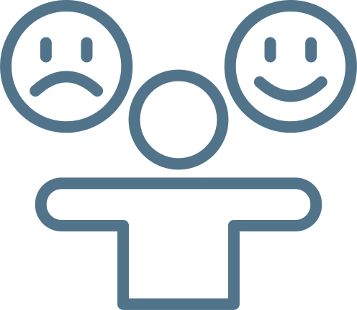


  The Five C’s of Executive Presence
Confidence
Credibility
Composure
Connection
Charisma
As you increase awareness of these items, still keep in mind that the goal isn’t performance.
If you’re coming prepared with insights that are authentically important to you and can support your people or the organization, then executive presence will follow more naturally.
Notes:
Additional Info for Consideration:
Decision-making
Handling Challenges
Adaptability
Myths
1. Confident people tend to be the loudest in the room. Not true. That might be true, but true confidence often shows up in quiet ways. It isn’t about how much you speak or how often you try to prove yourself—confident people don’t need to.
2.Confidence is built when you are winning. Not true. Real confidence is built in the tough moments, when you fail, get back up, and try again. At its core, confidence is curiosity, the drive to learn, grow, and keep going.
Charisma = persuasiveness

Slide 45
Executive Presence Roadblocks
Fear of Failure
Have you experienced any of these roadblocks? How did you overcome them?
Comparison
Steps You Can Take
  Trusting yourself to take action, even when you feel uncertain.
  Showing up and doing your best without needing to be perfect.
  Feeling grounded in your ability to handle challenges and learn from mistakes.
Negative Self-Talk
Lack of Clarity
Start showing up as the version of you who already has the confidence, clarity, and success you want.
Ask yourself: What would future me do?

Slide 46
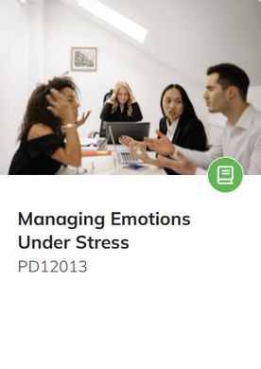
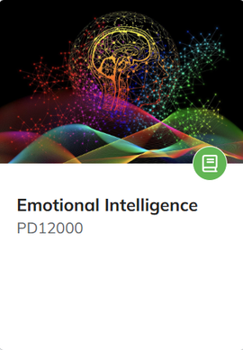
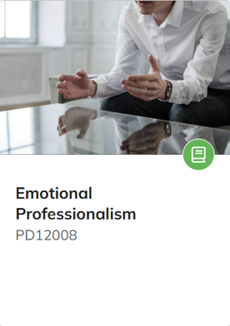
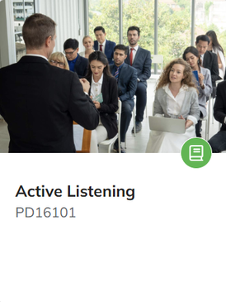
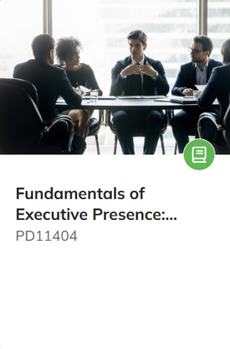
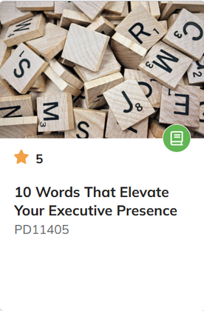
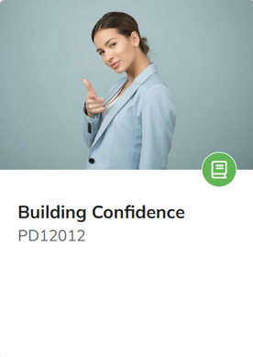
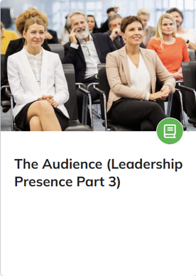
Perry University Resources

Slide 47
SECTION VI
  Introduction to Leadership Styles

Slide 48

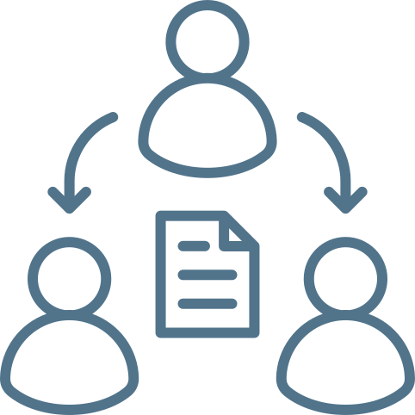



The Six Primary Leadership Styles
Transformational
Authoritative
Delegative
Empowers change & growth
Confident vision & direction
Hands-off guidance & trust
Transactional
Participative
Servant
Rewards-based results
Collaborative decision-making
Developing & supporting people
Notes:
As recognized by IMD Business School. IMD is one of the top universities in Lausanne, Switzerland. It is ranked #38 in Executive MBA Rankings - Global 2025.

Slide 49
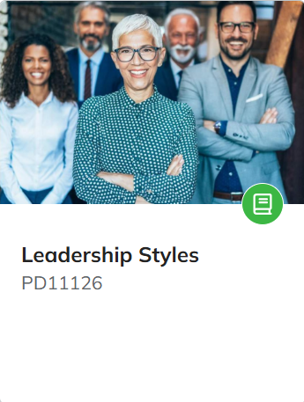
Next Steps
Complete the following course on Perry University before 3/12.
During this virtual session, participants will be guided through an engaging and meaningful discussion centered around the designated topic.

Slide 50
  Leadership is about making others better as a result of your presence and making sure that impact lasts in your absence.

Slide 51
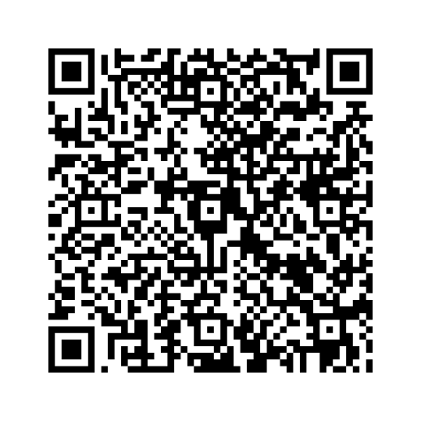
HEADQUARTERS
Emerging Leaders
  Thank you.
ANY QUESTIONS?

Slide 52
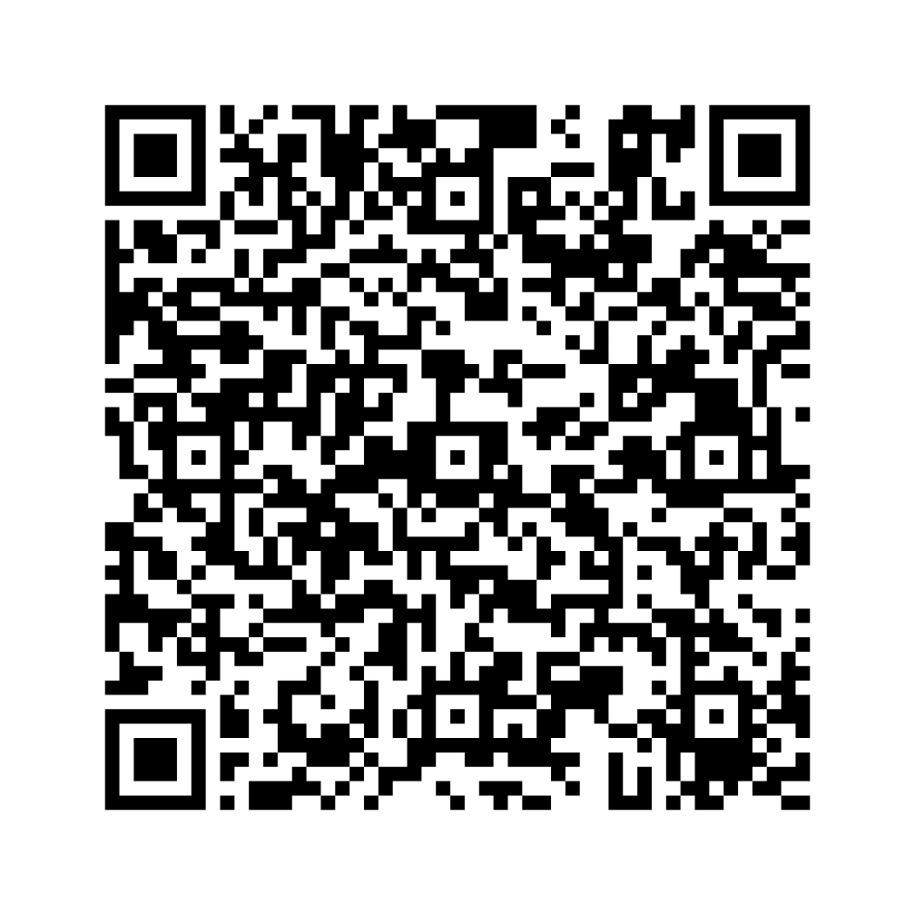
2-Day QR Code

